Slide 1
Stepper Motor Info and Sourcing
Guichet, Chang
Feb 20, 2013

Slide 2
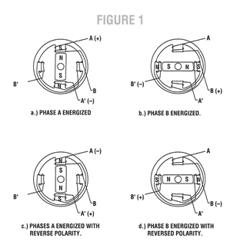
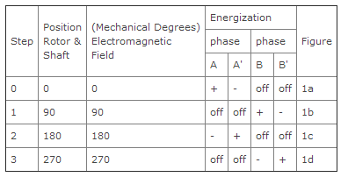
Stepper Motor Basics
Digital input output device
Spins in precise increments, instead of continuously in one direction
Notes:
http://www.applied-motion.com/products/stepper-motors

Slide 3
Terminology
Controller: system consisting of a DC power supply andpower switches plus associated circuits to control switches in proper sequences.
Driver: electronic package to convert digital step and direction inputs to currents to drive step motor
Holding torque: maximum restoring torque that is developed by energized motor when shaft is slowly rotated by external means
Microstepping: technique in which motor steps are electronically divided by the drive into smaller steps
Oscillator: device used to produce pulses for driving a step motor at a preset speed
Torque gradient: ratio of change in holding torque for a particular change in shaft position
Notes:
http://www.applied-motion.com/products/stepper-motors

Slide 4
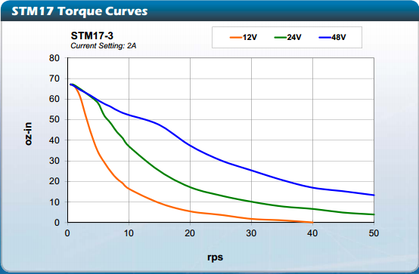
Torque Characteristics
Speed versus torque exerted
Notes:
http://www.applied-motion.com/sites/default/files/STM-Datasheet-925-0009.pdf

Slide 5
Driving Methods
Purchase integrated stepper + driver
Purchase separate driver
Build our own driver (instructables using breadboards, etc.)

Slide 6
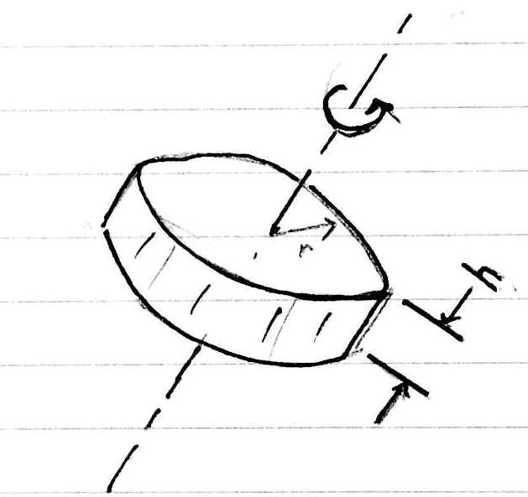
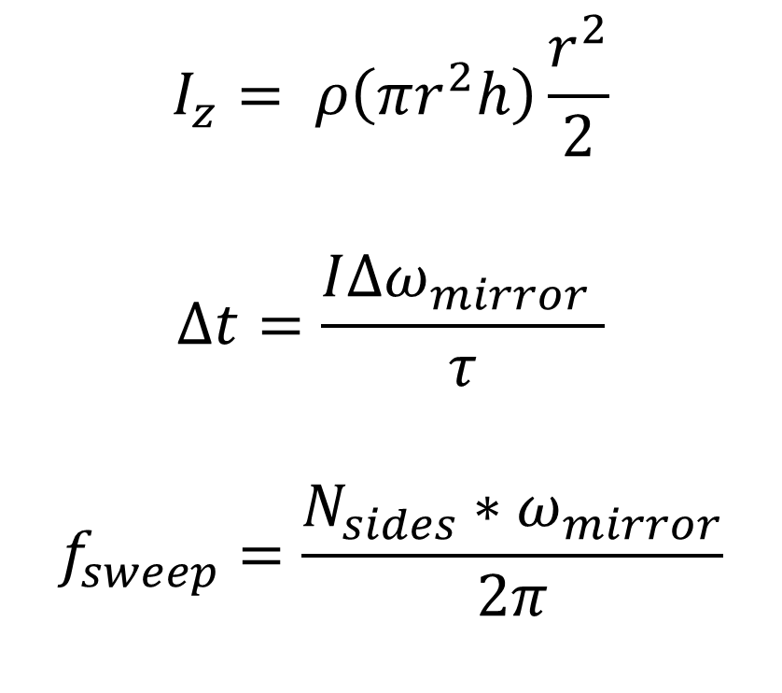
Torque Spec
$$I_{z}= ρ\left(πr^{2}h\right)\frac{r^{2}}{2}$$
$$∆t=\frac{I∆ω_{mirror} }{τ}$$
$$f_{sweep}=\frac{N_{sides}∗ω_{mirror}}{2π}$$
Notes:
http://olypen.com/nwbell/handbell/sidenote/frequency.html
1/24 (Frame rate for movies)

Slide 7
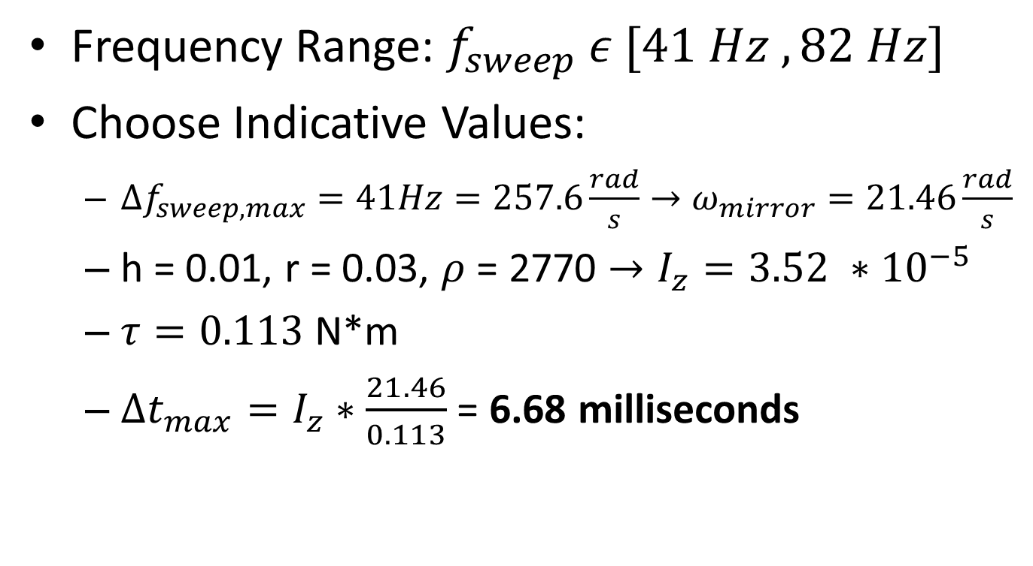
Bandwidth Estimation
Frequency Range: $f_{sweep} ε [41 Hz , 82 Hz]$
Choose Indicative Values:
$∆f_{sweep, max}=41Hz=257.6\frac{rad}{s}→ω_{mirror}=21.46\frac{rad}{s}$
h = 0.01, r = 0.03, $ρ$ = 2770 $→I_{z}=3.52 ∗{10}^{−5}$
$τ=0.113$ N*m
$∆t_{max}=I_{z}∗\frac{21.46}{0.113}$ = 6.68 milliseconds
Notes:
http://www.applied-motion.com/sites/default/files/STM-Datasheet-925-0009.pdf
Frequency range is first octave of bass guitar

Slide 8
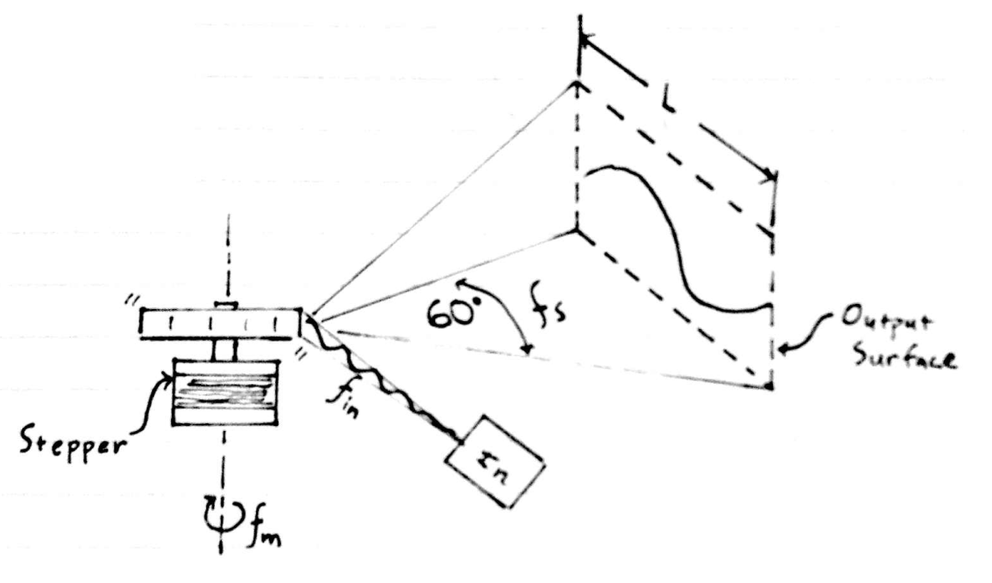
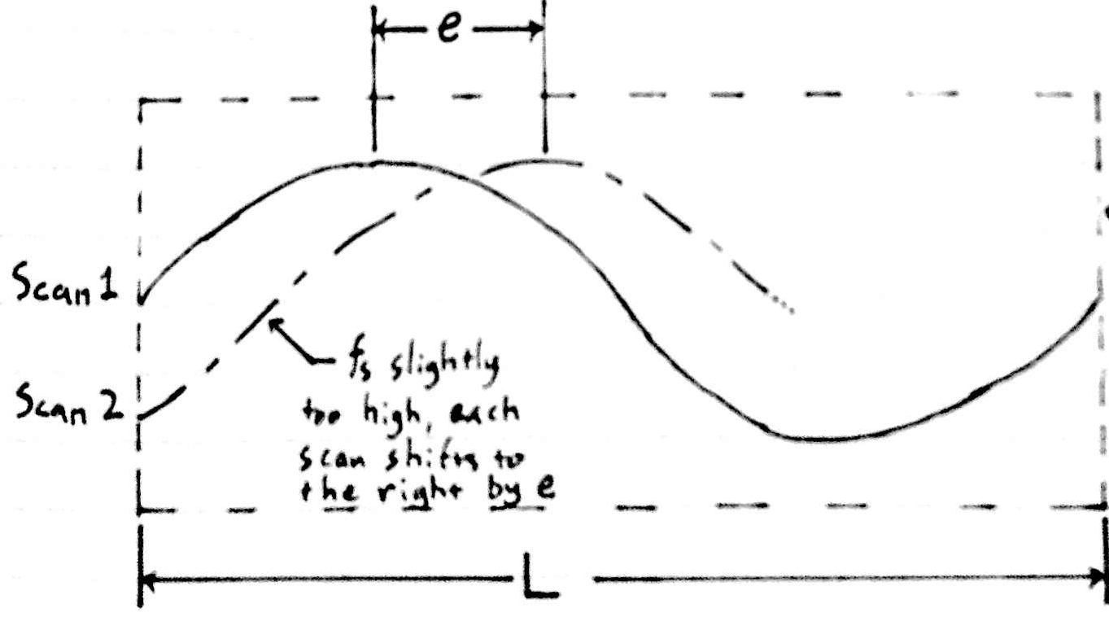
Velocity Precision
Notes:
*figuring out rate of creep (to the right) how much faster motor is than input

Slide 9
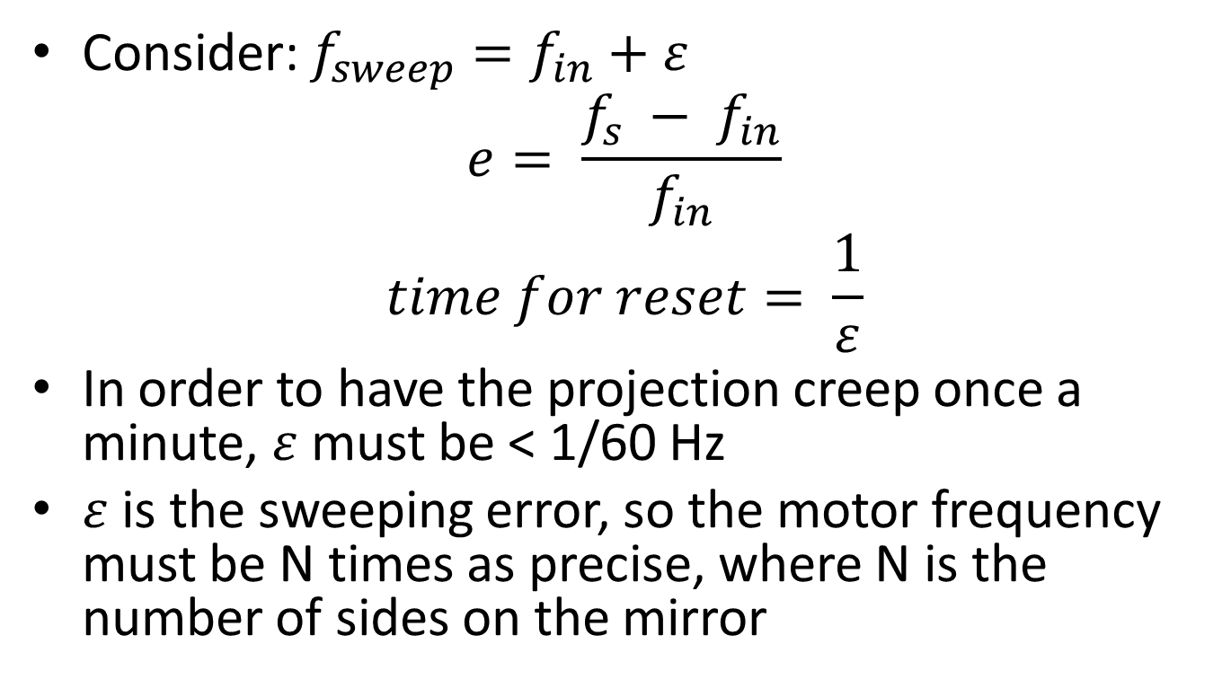
Velocity Precision
Consider: $f_{sweep}=f_{in}+ε$
$$e= \frac{{f_{s} − f}_{in}}{f_{in}}$$
$$time for reset= \frac{1}{ε}$$
In order to have the projection creep once a minute, $ε$ must be < 1/60 Hz
$ε$ is the sweeping error, so the motor frequency must be N times as precise, where N is the number of sides on the mirror
Notes:
http://rogue-code.googlecode.com/svn-history/r105/wiki/ToneLibraryDocumentation.wiki

Slide 10
Sources
Digikey
Bare Motors
www.digikey.com
Applie Motion
Motor units, drivers, software
Applied-Motion.com

Slide 11
Recommendation
Purchase integrated driver unit from applied motion ($130-$199), control using microcontroller tone() function (velocity precision will be about 100 times better than benchmark from previous slide)
Currently talking to AM about sponsorship, should we ask for money beyond the motor?
Notes:
http://www.applied-motion.com/sites/default/files/STM-Datasheet-925-0009.pdf

Slide 12
Appendix A – Tech Support Chat Applied Motions – Feb 20, 2013
Chat session started at 2:28:58 PM Please be patient while you are being connected with an operator ... You are now chatting with Matt Matt: Hello and thank you for your interest in Applied Motion Products. Please allow me a moment to review your question. Matt: Which model were you looking at, Christopher? Christopher: Hello, I'm looking at the STM17C-3CE integrated stepper Christopher: This is for a student project, the only functionalities I will be using from the driver is the driving circuity and velocity setting Matt: Ok, so will you be sending velocity commands via CANopen? Christopher: I would like to use a microcontroller, CANopen uses a computer right? Matt: Well, you would need a CAN host and special hardware for that. You might consider the STM17S-3AE instead. Christopher: I see! sorry I'm still learning how to navigate the products. I just now saw that the 3CE has CANopen as the only listed control mode Christopher: I also just found the sentence "The analog input accepts 0-5 VDC signals and can be used for velocity and position control." Matt: Right, that one is a bit specialized. Matt: Yes, that is true. You could use the analog input to control velocity. You could also send commands from a PC using our SCL Utility. Matt: I will need to verify the accuracy for each method. What sort of accuracy are you looking for? Christopher: This is going to be in an embedded project, so it will most likely be a microcontroller setting the velocity (using analog or serial communication) Christopher: I apologize I haven't done the calculation yet, may I assume that all 12 bits of ADC precision will be used across the velocity range Matt: That's what I would like to verify. May I have your email address, so that I can send you an email once I confirm that? Christopher: That would be great! my e-mail address is cguichet@gmail.com Matt: Thanks Christopher. I will look into this and get back to you. Christopher: Thank you for your help Matt, have a nice day Matt: Thank you for contacting Applied Motion Products. Have a nice day!

